Slide 1

Robust Graph Neural Networks
Reporter: 張瓊文 March 2022
Presentation: https://youtu.be/O4PxLr0cD0w

Slide 2
Motivations
The graph with noisy and limited labels could significantly degrade the performance of GNNs for semi-supervised node classification
How would noisy labels affect the analysis of graph?
Because of the limitation of labels node numbers and noisy labels, the training may overfit to noisy labels and result in poor generalization.
Sparsely labeled graph & message passing to unlabeled neighbors
→ could not modified the noisy labels and affect by these samples easily
1
0
B
For unknown label node D in this graph, its neighbor B is a noisy label which could negatively affect classification result.
D: 1/3 probability would be misclassify to class 1 because of noisy label B and this could be more significant when the neighbors of unknown node are little.
Because node G links with only two nodes, if one of the neighbors is noisy the prediction would be poor.
A
1
C
D
1
0
H
F
E
1
I
1
G
Noisy label: B, G

Slide 3
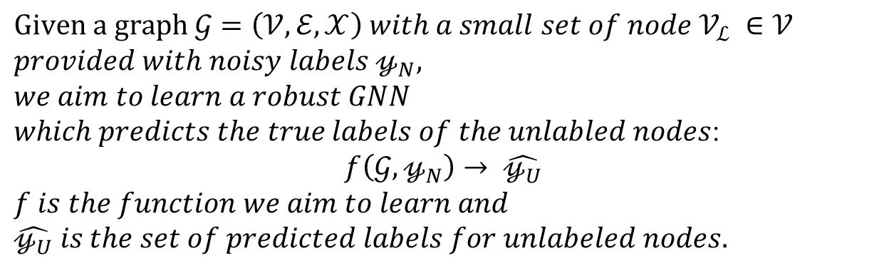
Problem Statement
$$Given a graph 𝒢=\left(𝒱,ℰ,𝒳\right) with a small set of node 𝒱_{ℒ} ∈𝒱$$
$$provided with noisy labels 𝓎_{N},$$
$$we aim to learn a robust GNN$$
$which predicts the true labels of the unlabled nodes$:
$$f\left(𝒢,𝓎_{N}\right)→ \hat{𝓎_{U}}$$
$$f is the function we aim to learn and$$
$\hat{𝓎_{U}} is the set of predicted labels for unlabeled nodes.$
Sparsely labeled Graph
f
Predict for unlabeled nodes
Noisy labels

Slide 4
Technical Challenges
Prior works:
Assumption: large amount of noisy labels → knowing noise distribution and try to sample correct lables
i.i.d data: most of studies focus on convolution based networks can not handle information propagation of noisy labels
The topic of robust model focus on develop a robust GNN dealing with limited labeled data and noisy data.
However, there are some problems need to be solved:
1. It is hard to identify the noisy label.
2. Numbers of links between unlabeled nodes and labeled nodes could affect the prediction (s/n ratio)

Slide 5
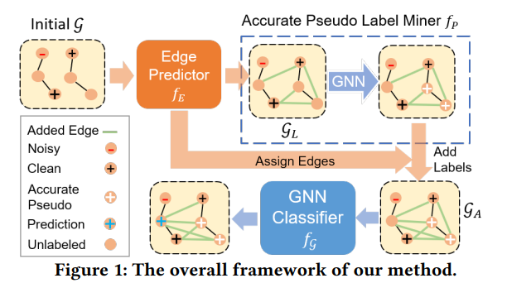
Related Work - 1
NRGNN: Learning a Label Noise-Resistant Graph Neural Network on Sparsely and Noisily Labeled Graphs
Noise resistant GNN:
Generate links with high feature similarity labeled nodes. Same class nodes should share similar features.
Extend labeled nodes with pseudo labels.
Overall, this method aim to bring more correct label information for unlabeled nodes.
[1] E. Dai, C. Aggarwal, and S. Wang, “NRGNN: Learning a Label Noise-Resistant Graph Neural Network on Sparsely and Noisily Labeled Graphs,” 2021.

Slide 6
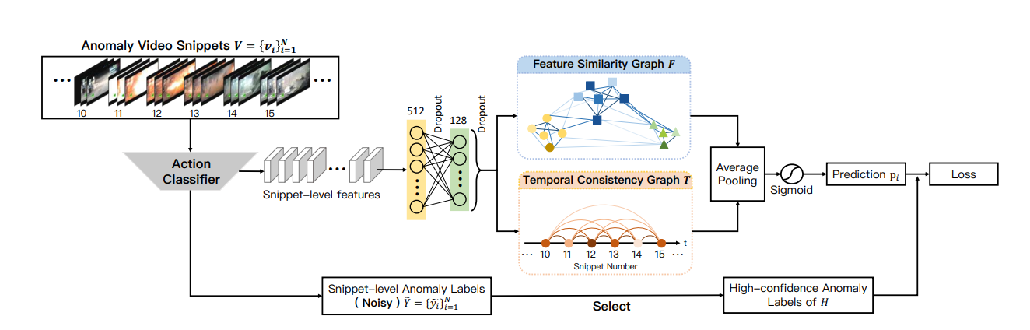
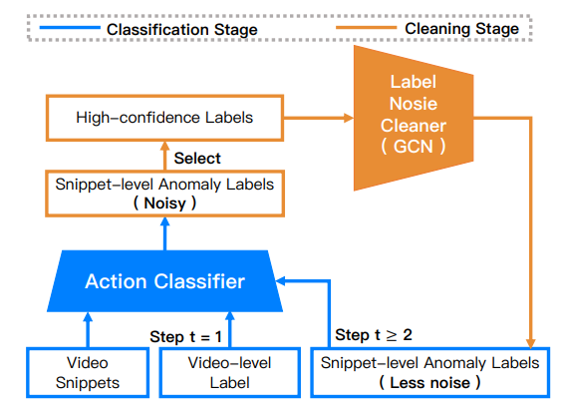
Related Work - 2
Graph Convolutional Label Noise Cleaner: Train a Plug-And-Play Action Classifier for Anomaly Detection
Multiple instance learning: positive/negative bags => noisy data in negative bags
[1] J.-X. Zhong, N. Li, W. Kong, S. Liu, T. H. Li, and G. Li, “Graph Convolutional Label Noise Cleaner: Train a Plug-And-Play Action Classifier for Anomaly Detection,” 2019 CVPR, pp. 1237–1246, 2019.

Slide 7
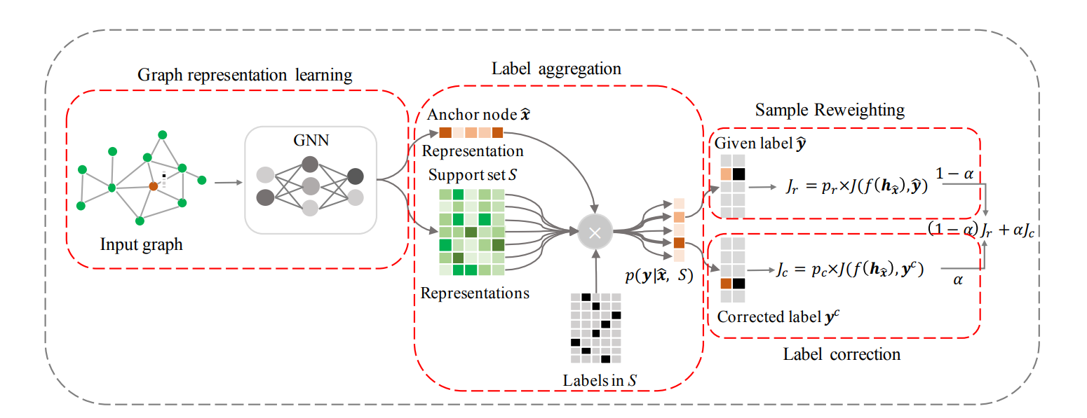
Related Work - 3
Unified Robust Training for Graph Neural Networks against Label Noise
Random walks to perform label aggregation among nodes with structural proximity
Estimate node-level class distribution to guide sample reweighting and label correction
More consistent with nearby labels contribute more gradient
Correct noisy label by assigning new label consistent with similar nodes
[1] Y. Li, J. yin, and L. Chen, “Unified Robust Training for Graph Neural Networks against Label Noise,” 2021.

Slide 8
Dataset
Dataset: cora, citeseer
https://github.com/EnyanDai/NRGNN/tree/main/data
The Cora dataset consists of 2708 scientific publications classified into one of seven classes. The citation network consists of 5429 links. Each publication in the dataset is described by a 0/1-valued word vector indicating the absence/presence of the corresponding word from the dictionary. The dictionary consists of 1433 unique words.
The CiteSeer dataset consists of 3312 scientific publications classified into one of six classes. The citation network consists of 4732 links. Each publication in the dataset is described by a 0/1-valued word vector indicating the absence/presence of the corresponding word from the dictionary. The dictionary consists of 3703 unique words.
Label noises:
• Uniform Noise: The labels have a probability of 𝑝 to be uniformly flipped to other classes.
• Pair Noise: Labelers are assumed to make mistakes only within the most similar pair classes. More specifically, labels have a probability of 𝑝 to flip to their pair class.
https://paperswithcode.com/dataset/cora
Notes:
Supervised learning: strong supervision in terms of precise bounding boxes
Without precise annotations

Slide 9
Preliminary Methods
To solve two challenges for robust model, we need to deal with label sparsity and noisy labels.
NRGNN propose:
1. Edge prediction to generate more links to facilitate the information propagation
2. Pseudo label miner provide more pseudo labels according the feature similarity
3. GNN classifier use the pseudo labels and links to predict final results
Inspired by self-training mechanisms in image and nlp, consistency regularization achieve great performance on training a robust model. Such that, two augmented images should share similar features. Model perturbation and data augmentation are common methods to perform consistency regularization.
Notes:
Supervised learning: strong supervision in terms of precise bounding boxes
Without precise annotations

Slide 10
Preliminary Methods
In NRGNN, this method do not correct noisy labels. Simply increase the s/n ratio.
Consistency regularization
Train two random initial models and predict class for label nodes. If the labels is inconsistent then flip this label to unknown class.
Aggregate node features in same class as feature centroid.
Assign new label for flipped noisy node according to the max similarity with feature centroid.
Accuracy as evaluation metric

Slide 11
Expected Time Schedule
Complete feature centroid aggregate
+
Model perturbation
Train the model and test in dataset
Document writing and ablation study
Run NRGNN code
5/18
6/1
6/10
6/12

Slide 12
THANKS!

